Slide 1

Data Visualization
30-4-2024

Slide 2

What is Data Visualization?
Graphical Representation of data and information
Includes →
Basic charts and graphs
Interactive dashboards and maps

Slide 3

Why build visuals?
Easily understand data visually rather than raw data.
Highlights patterns, trends and relationships.
Also, communicates insights → simplifies data for stakeholders.

Slide 4

Data Visualization in Different Fields
Business & Finance
Health Care
Education
Government
Research & Science
Entertainment

Slide 5
How to accurately represent Data?
Choose the right type of Visualization Techniques.
1
Line chart → trends over time
Bar chart → comparing values
2
Use clear Labelling and Formatting.
3
Avoid unnecessary animations.
4
Focus on main point for visualizations.
5
Consider the audience (Important)
6

Slide 6
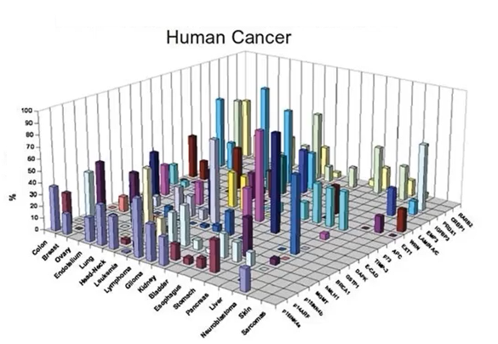
Bad Example Data Visualization

Slide 7
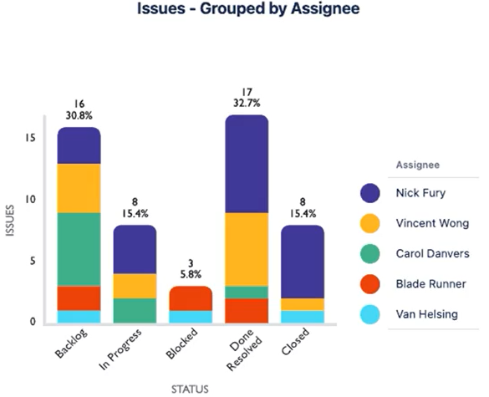
Good Example Data Visualization

Slide 8

Dark Horse Analytics
Company created in 2008 helps in data visualization.
When creating a visual, always remember,
Less is more effective
Less is more attractive
Less is more impactful
Visit https://www.darkhorseanalytics.com/ for data visualization projects.

Slide 9

Types of plot
1. Line plot
2. Bar plot
3. Scatter plot
4. Box plot
5. Histogram

Slide 10
Line Plot (Line Chart)
Displays data as a series of data points connected by straight lines.

Slide 11
Use Case
Display trends over time.
Compare datasets with a continuous independent variable.
Illustrate cause-and-effect relationships.
Visualize continuous data.
Notes:
Stock exchange, Temperature change
Age and time
Sales revenue changes based on marketing budget
Height measurements over time

Slide 12
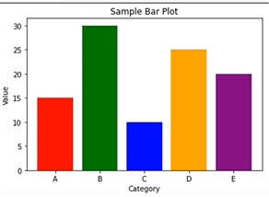
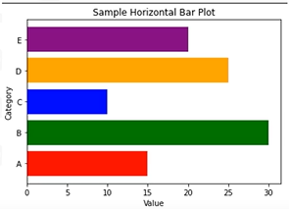
Bar Plot (Bar Chart)
Displays data using rectangular bars.
The height or length of the bars represents the magnitude of the data.
Displays bar either vertically or horizontally.

Slide 13
Use Case
Compare different categories or groups.
Visualize data that you can easily rank or ordered.
Good Example Bad Example
Notes:
Sales data by product.
%age of sale of a book by ranking

Slide 14
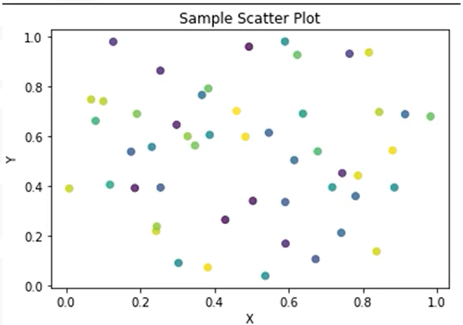
Scatter Plot
Uses coordinates to display values of two variables.
Value of one variable determines the position on the x-axis (horizontal) and the value of another variable determines the position on the y-axis (vertical).

Slide 15
Use Case
Examine the relationship between two continuous variables.
Investigate patterns or trends in data.
Detect outliers or unusual observations.
Identify clusters or groups in the data.
Notes:
Temperature and energy consumption.
House prices and size.
Ab normal stock prices.

Slide 16
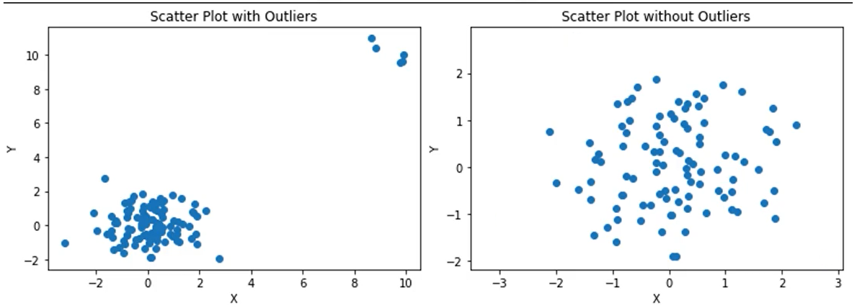
Scatter Plot (outliers)

Slide 17
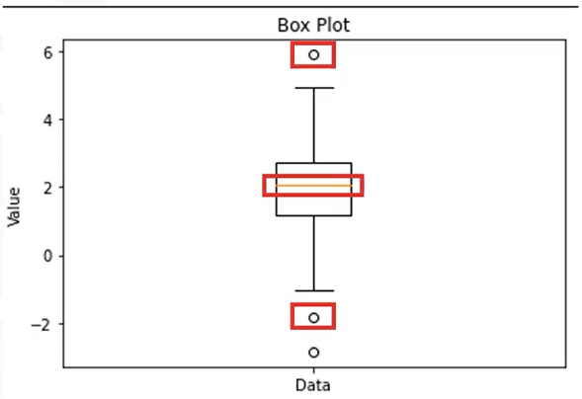
Box Plot (Whisker plot)
Displays the distribution of a dataset along with key statistical measures.
Represents the interquartile range as a box, a median line, and whiskers indicating range.
Represents outliers as individual data points beyond whiskers

Slide 18
Use Case
Compare
Compare the distribution of a continuous variable across different categories or groups.
Examine
Examine spread of a dataset, visualizing quartiles.
Box
Box plot gives valuable information about the outliers, such as their appearance and their extend. Ignoring outliers sometimes leads to misinterpretation.
Notes:
1. Employee’s salary across departments.

Slide 19
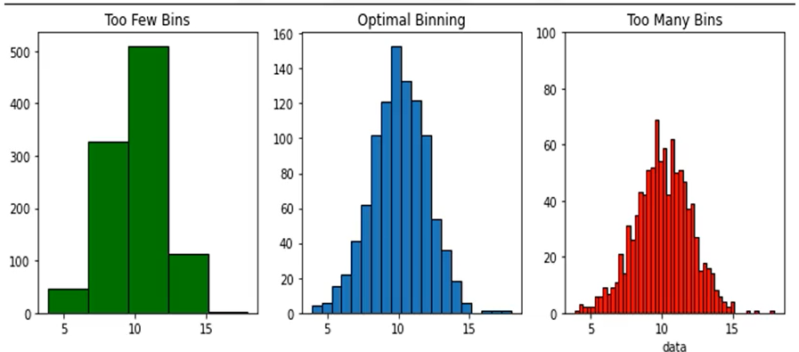
Histogram
A graphical representation of dataset distribution.
Shows frequency within intervals.
Bars represents the data count in each interval.
Visually depict the shape of the data.
Notes:
Too few – 5 bins
Optimal – 20 bins
Too many – 50 bins

Slide 20

Recap
Various types of plots commonly used in data visualization.
Line plots: Shows trends and changes over time.
Bar plots: Compares categories or groups.
Scatter plots: Examine relationships b/w variables.
Box plots: Displays distribution and identifies outliers.
Histograms: Illustrates data distribution within intervals.

Slide 21
Data Visualization Libraries
Matplotlib
Pandas
Seaborn
Folium
Plotly
PyWaffle

